Slide 1
Springleaf marketing response
Final seminar presentation (AML-R)
Marcus Cramer, Markus Heuchert

Slide 2







We use an (adjusted) version of the crisp-DM framework for data mining
SOURCE
Business Understanding
Data Understanding
DATA
Data Cleaning
Deployment
Modeling
Evaluation
Source: Chapman et al. (2000)

Slide 3
We use an (adjusted) version of the crisp-DM framework for data mining
SOURCE
Business Understanding
Data Understanding
DATA
Data Cleaning
Deployment
Modeling
Evaluation
Source: Chapman et al. (2000)

Slide 4

Agenda
Data understanding
Data cleaning
Value imputation
Machine learning approaches
Results
Source: https://learnvest.global.ssl.fastly.net/wp-content/uploads/2014/04/Roadmap.jpg

Slide 5

The available train dataset is huge; and the test set is just as big
1,932 features (completely anonymized)
Numerics
Strings
Binary target
145,231 obeservations
Factors
NAs
Dates
The immense size of the dataset and the variety of anonymized features makes qualitative analysis impossible.

Slide 6
Different attribute types must be handled separately
Number of attributes per attribute type

Slide 7
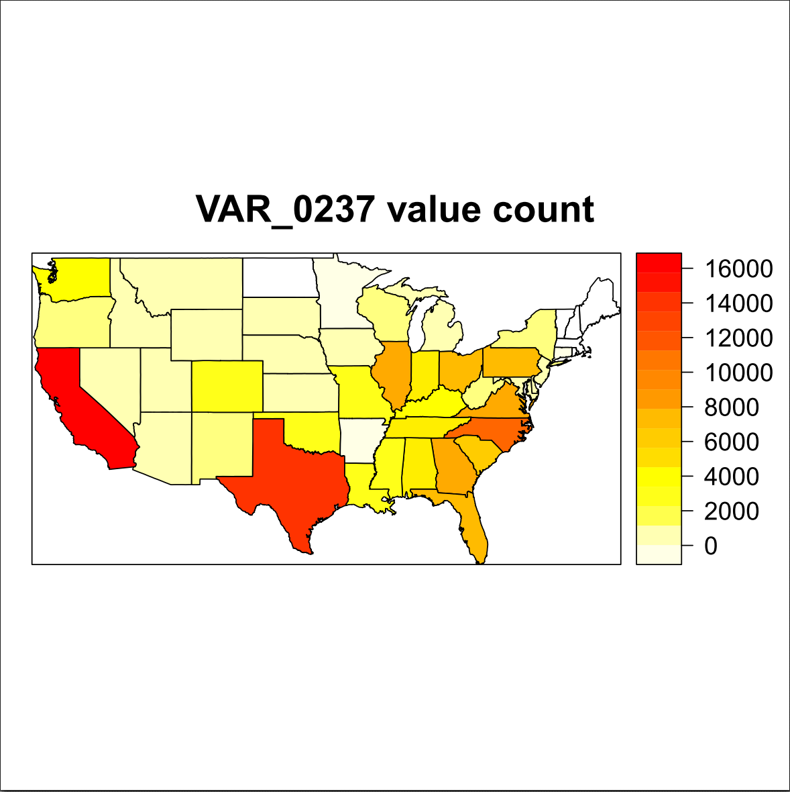
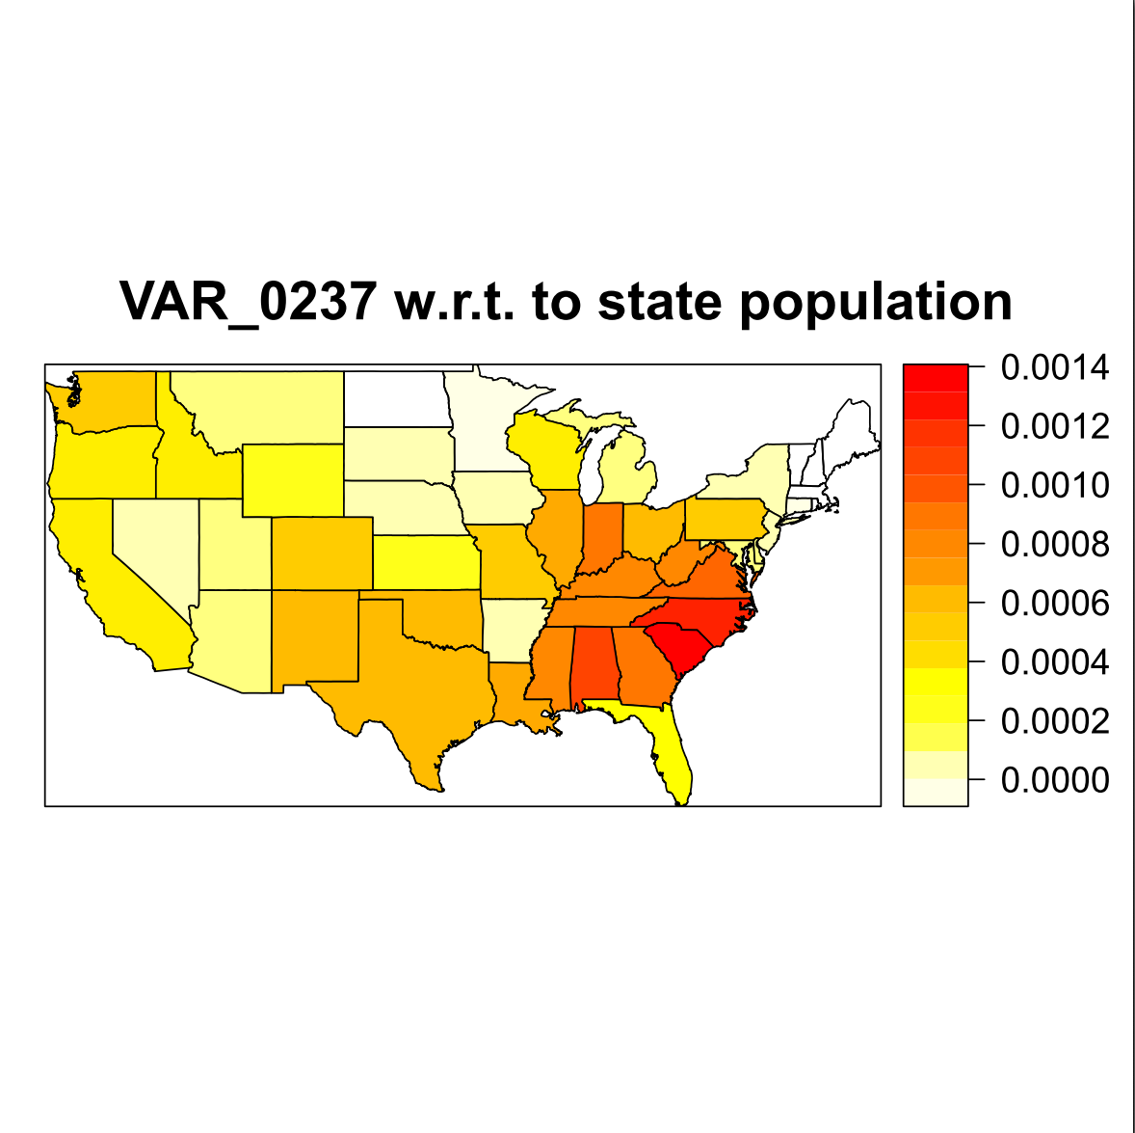
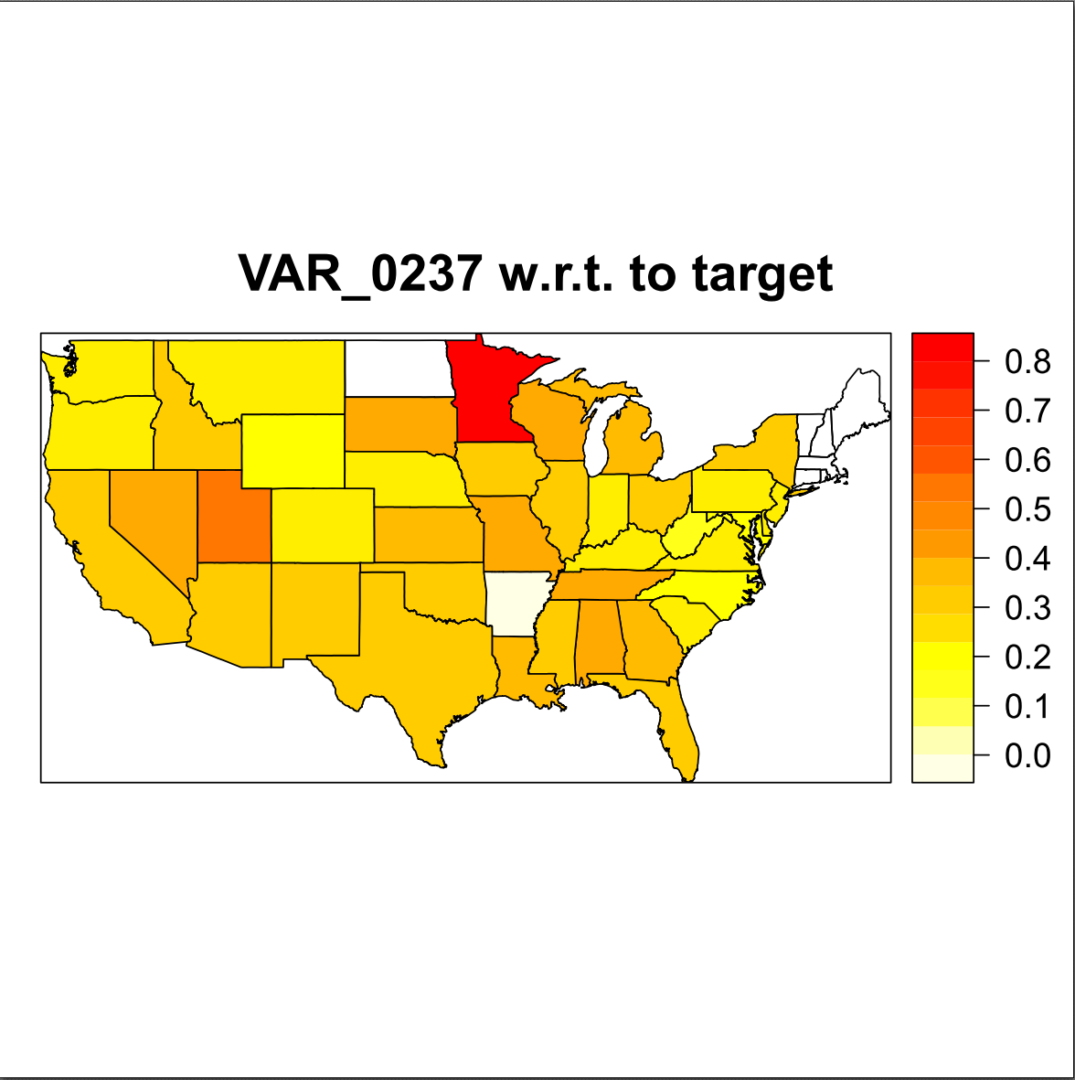
Numbers vary drastically among us states
Occurrences of US states
Occurrences w.r.t population
Target response rate

Slide 8
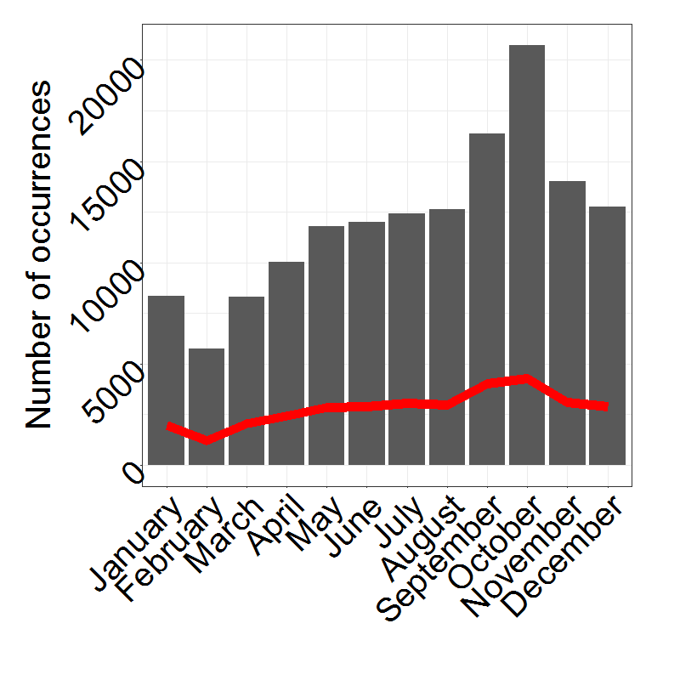
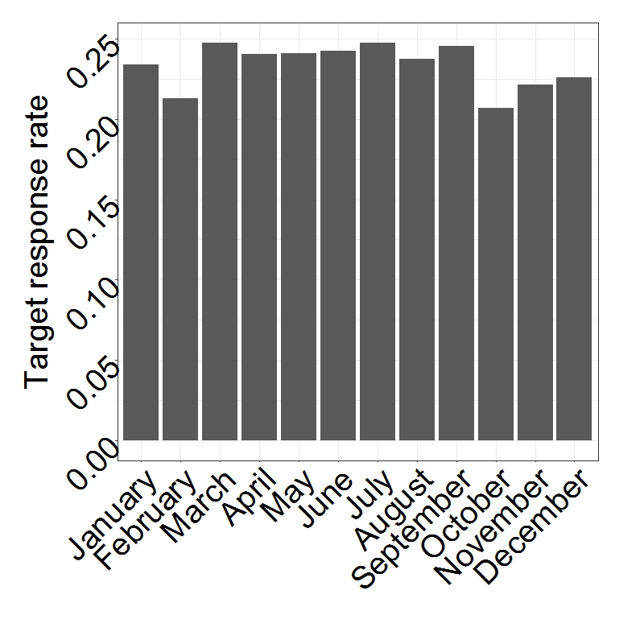
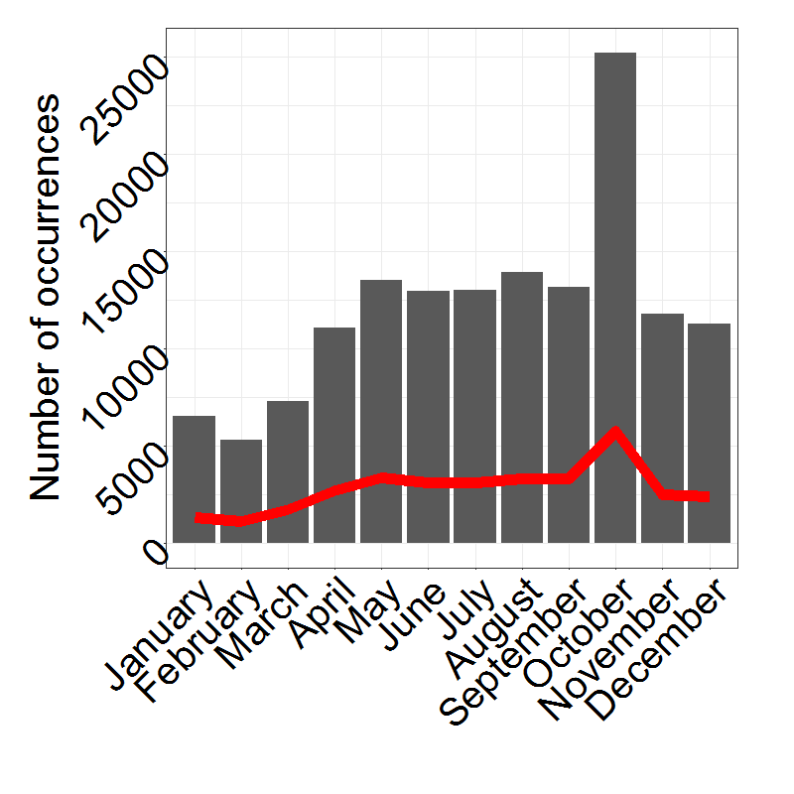
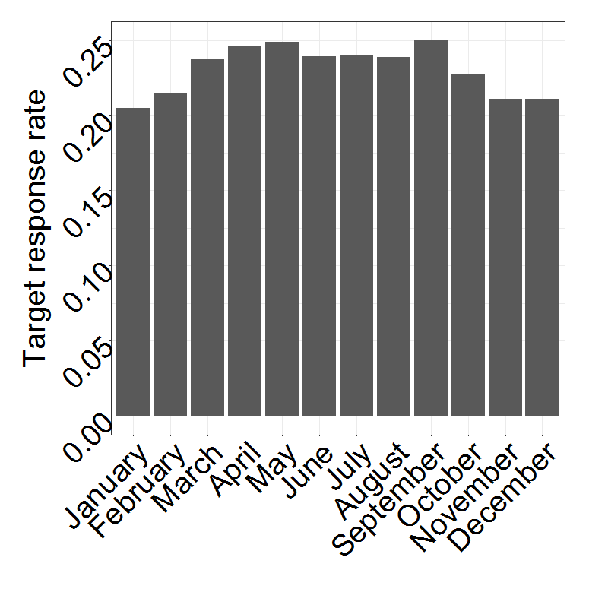
Numbers vary drastically For different months
Occurrences of months (2/16 features)
Target response rate of months

Slide 9
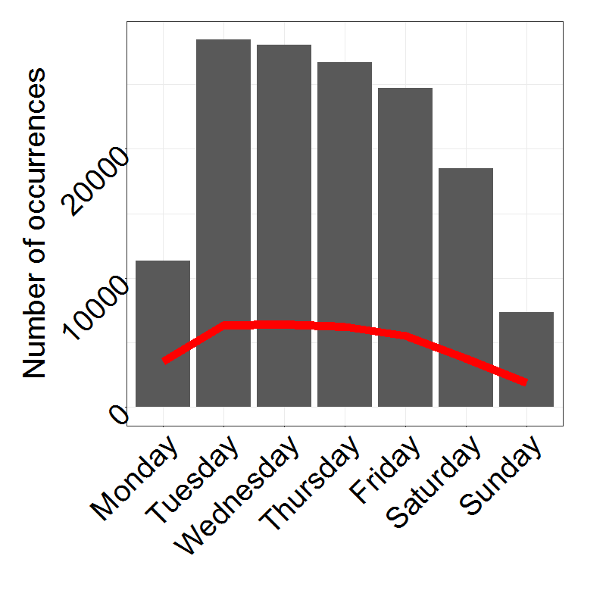
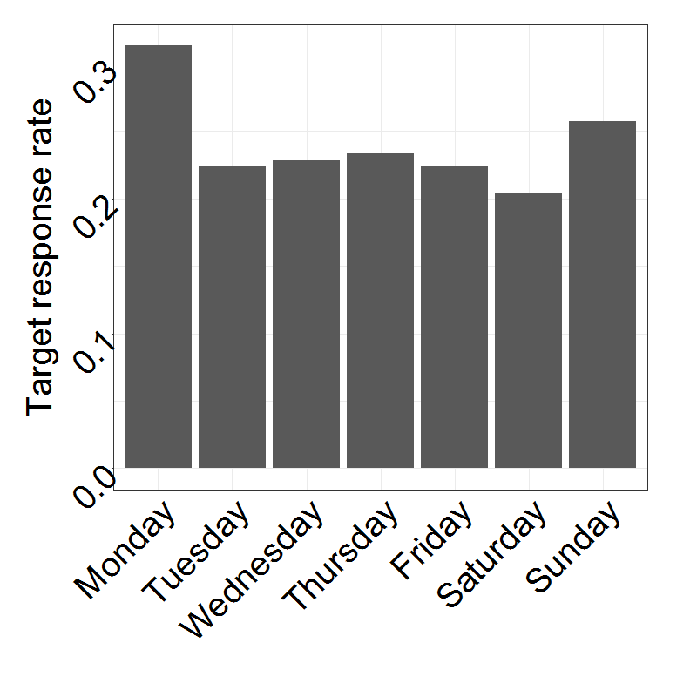
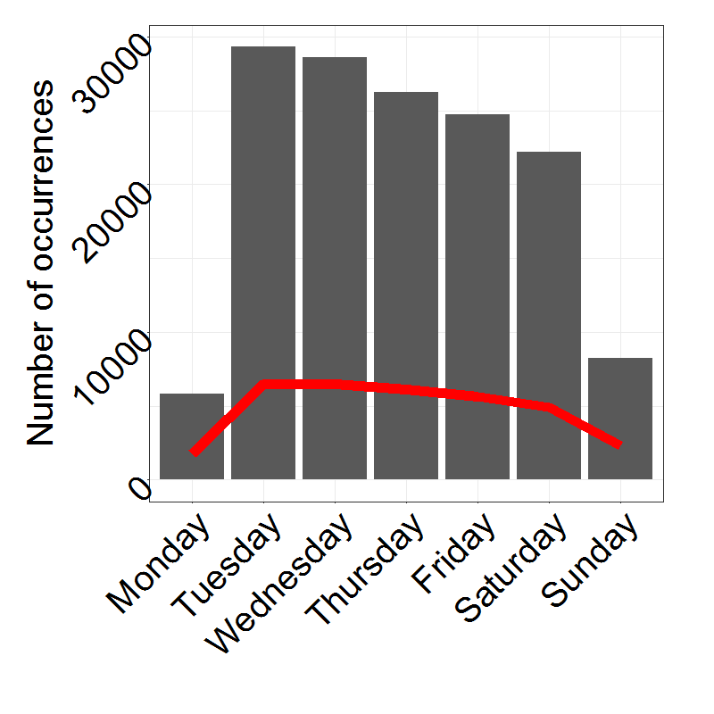
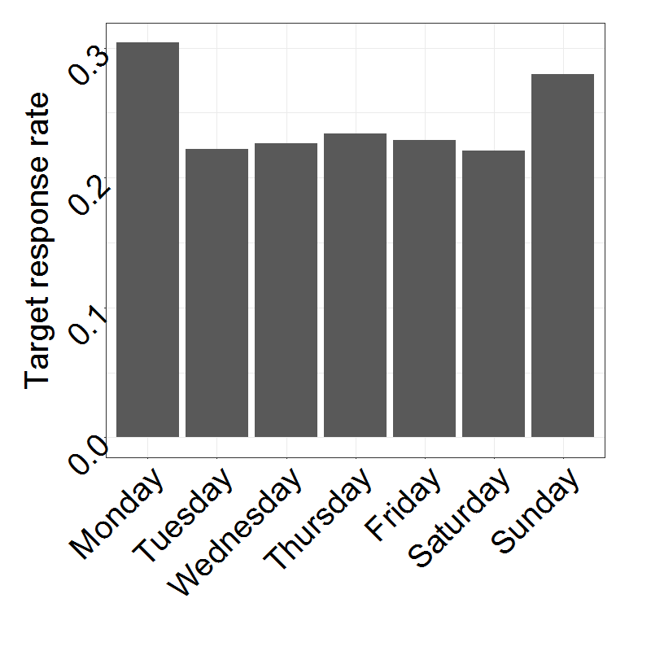
Numbers vary drastically FOR different Days
Occurrences of days (2/16 features)
Target response rate of days

Slide 10
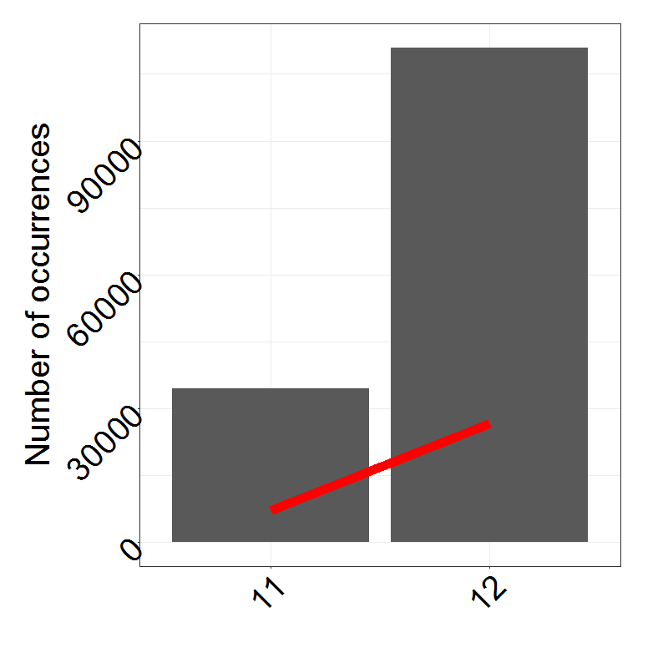
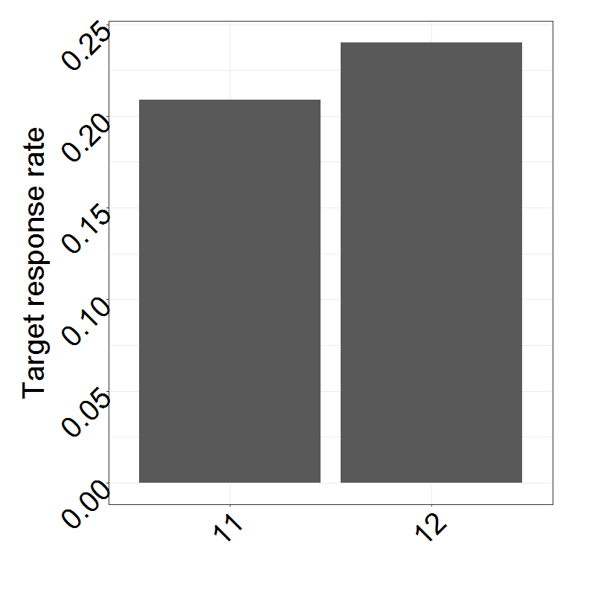
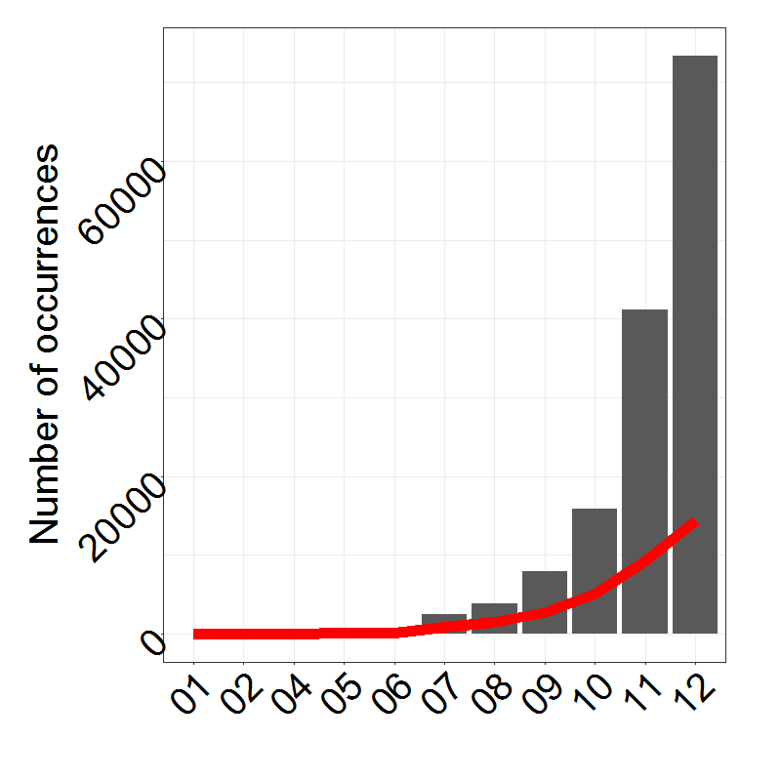
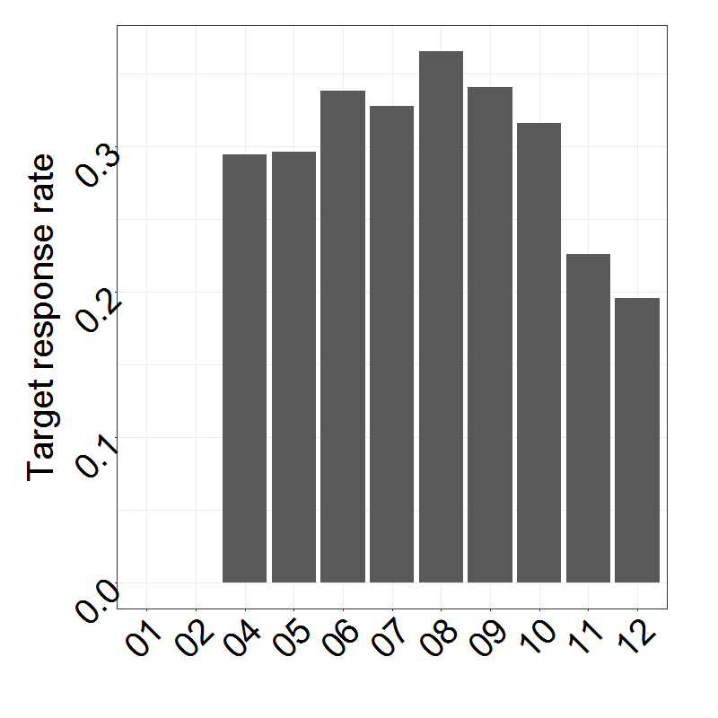
Numbers vary drastically FOR different Years
Occurrences of years (2/16 features)
Target response rate of years

Slide 11

Agenda
Data understanding
Data cleaning
Value imputation
Machine learning approaches
Results

Slide 12
Beautify
Different NA encodings
Obvious NAs: -1 (all other values positive), [], blank
More sophisticated:
Find columns with negative mean of unique values and remove outliers -> results in positive mean of unique values -> outlier = -99999 -> NA encoding
Take mean of unique values and mean of unique values minus one extremum on both sides -> if first value is more than 10 times higher than second value, we probably have an illogically high maximum value -> this is the case for 1+e09, 9999, 99, 100
Sometimes, the second highest value also seems to be some sort of NA encoding (same approach as above but removed second maximum too) -> 9996, 9998, 98
For other columns, a couple of extreme outliers exist. The maximum of extreme outliers is 5 values, which are more than 10000 times higher than the rest in the same column -> 999999999, 999999998, 999999997, 999999996, 999999995, 999999994
Everything double checked for plausibility with random manual samples
Made sure that data is unlikely to be factors (then these encodings might stand for sensible values)

Slide 13
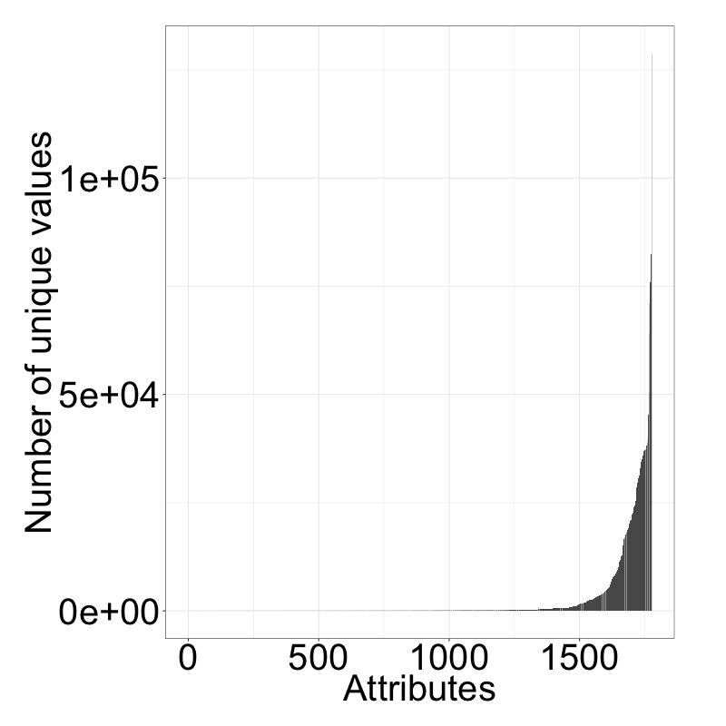
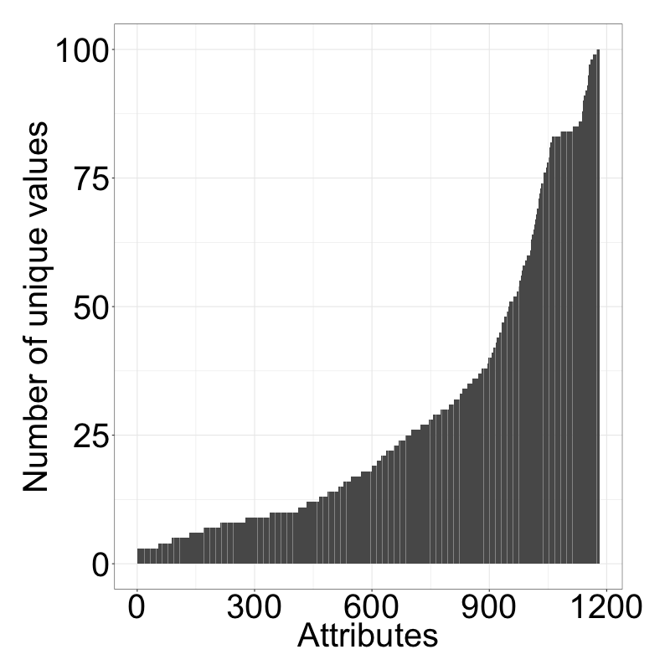
Numerical/categ. values hard to differentiate via “elbow-criterion”
Number of unique values per attribute
Number of unique values (<101)

Slide 14
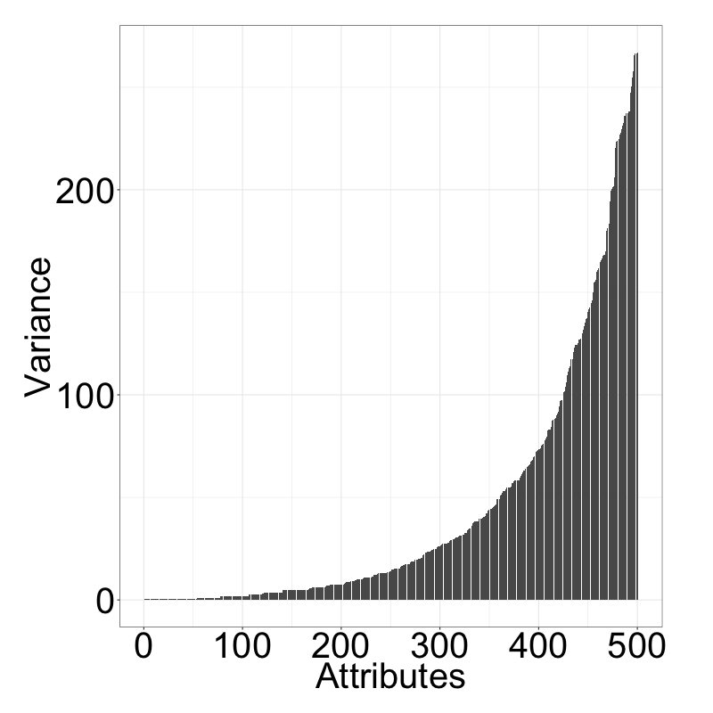
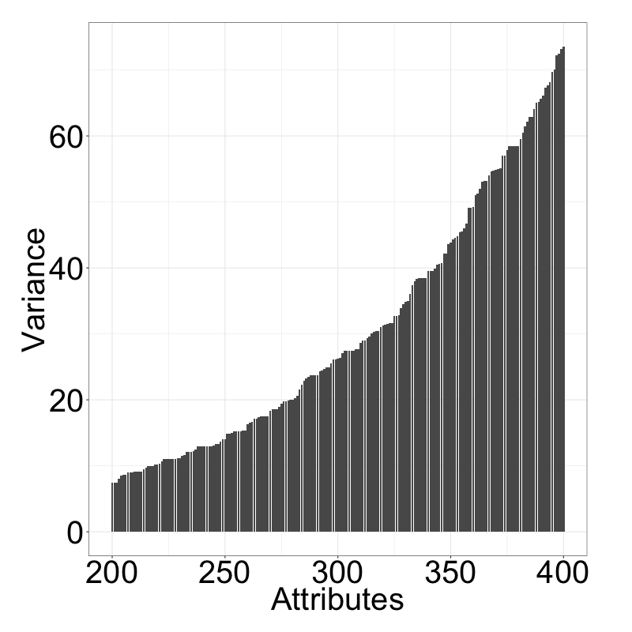
Elbow criterion applied to variances of unique values more insightful?
Var. between unique values (lowest 500)¹
Var. between unique values (200-400)
Elbows?
Elbow?
Highest difference between the 357. and the 358. attribute. We therefore assume, that the attributes 1-357 (sorted by variance) are candidates for categorical attributes.
1) Where the number of unique values is less than 101

Slide 15
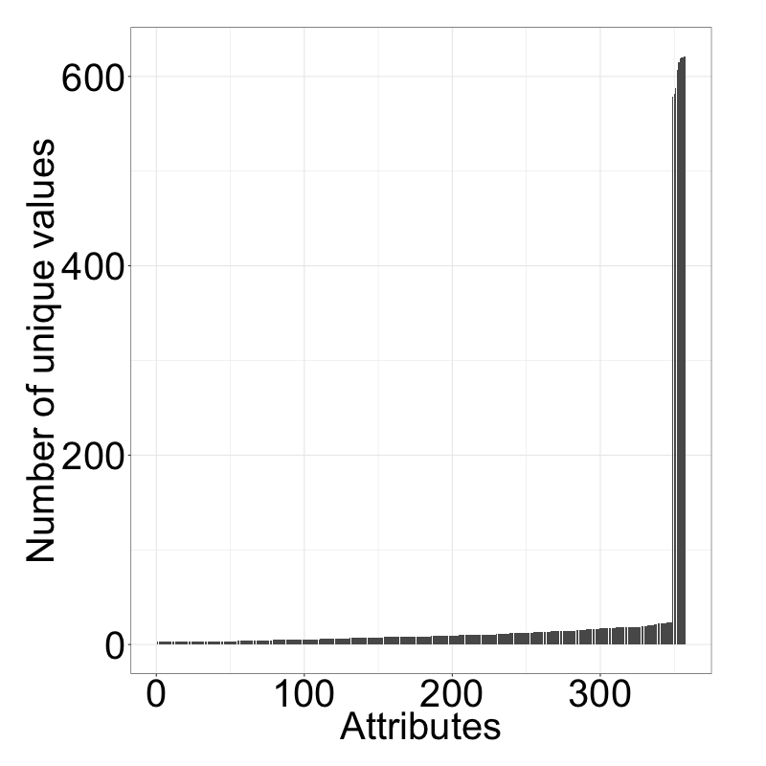
Reapplying this to the number of unique values reveals drastic elbow
Number of unique values per attribute
Highest gap between 348 and 349
First 348 attributes have less than 23 unique values
348 attributes likely to be factors
Elbow
We identified 348 attributes, that are likely to be categorical. This is just a rough estimate, however, as the meaning of attributes is unknown.

Slide 16
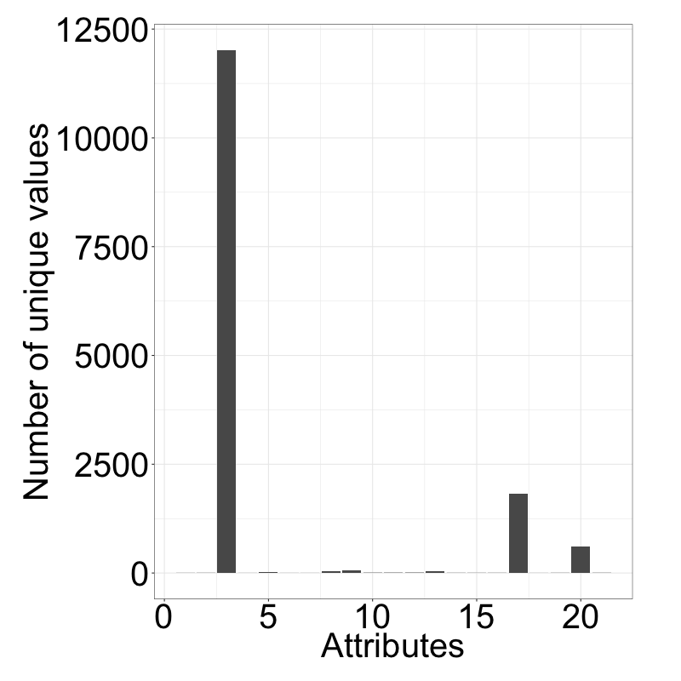
Number of unique values for strings differs greatly
Number of unique values per attribute
Too detailed, high chance of overfitting (and already included in US states)
Cities
Too detailed, high chance of overfitting)
US states
Job descriptions
99.99% NA values
We identified 348 attributes, that are likely to be categorical. This is just a rough estimate, however, as the meaning of attributes is unknown.

Slide 17
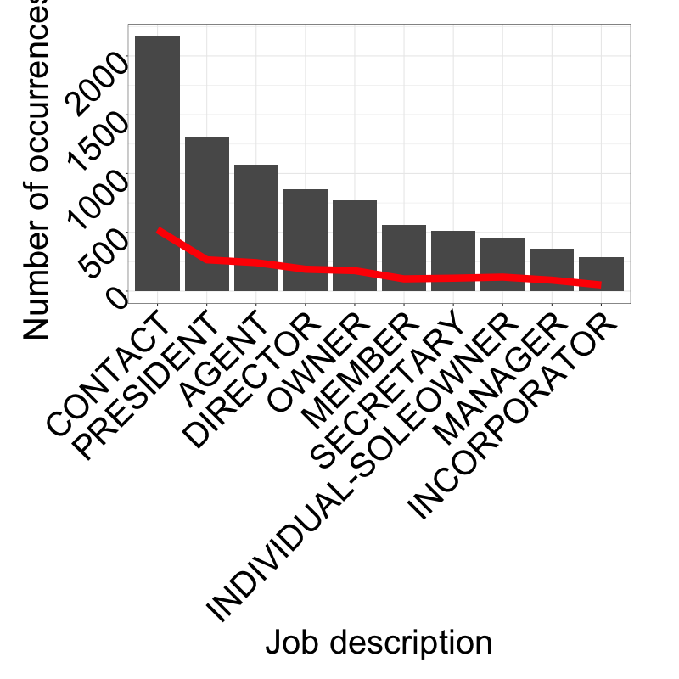
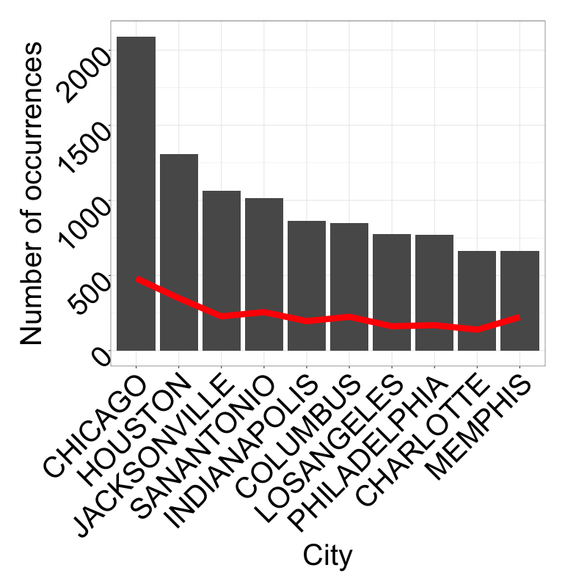
No Job description or city stands out in terms of total occurrences

Slide 18
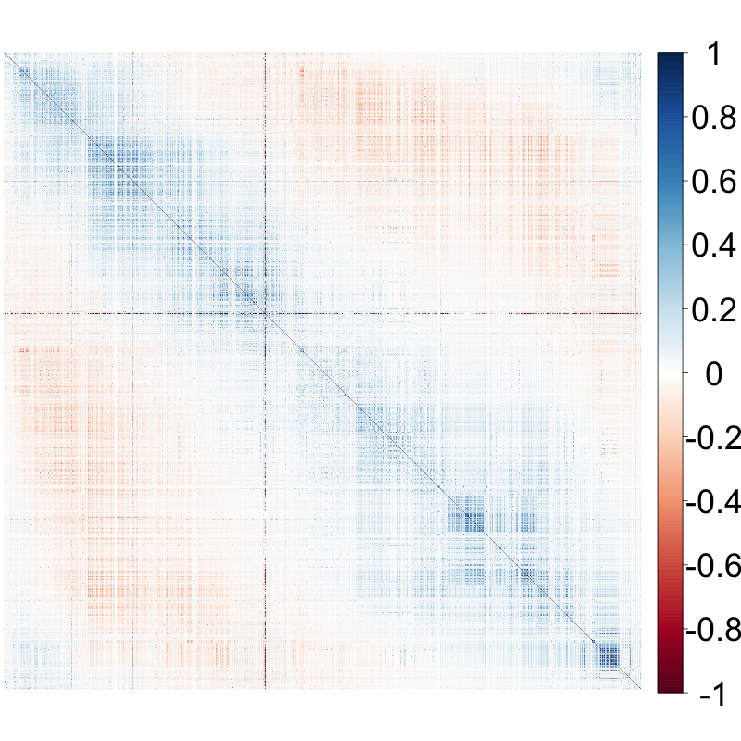
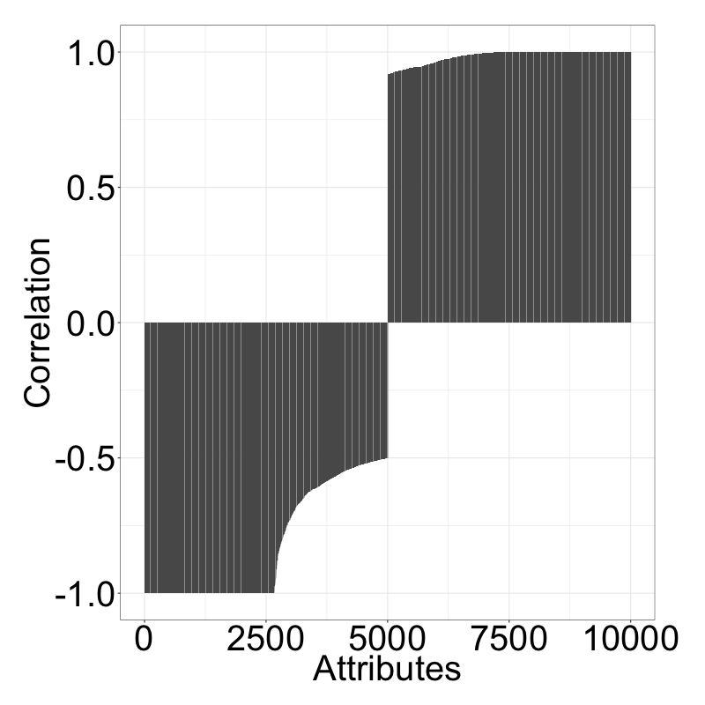
Some attributes with absolute pearson correlation of 1 discovered
Correlations between all atts. (ordered)
5000 lowest and highest correlations

Slide 19
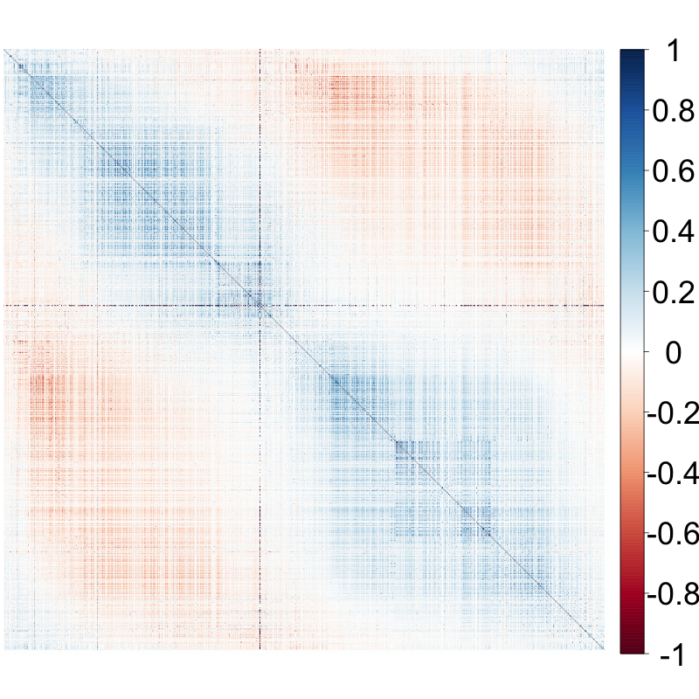
Similar picture for spearman rank correlations
Correlations between all atts. (ordered)
5000 lowest and highest correlations
45 entries with a correlation of 1 and 13 entries with a correlation of -1 could be identified (out of these 49 unique attributes). We can therefore remove these 49 attributes.

Slide 20

Agenda
Data understanding
Data cleaning
Value imputation
Machine learning approaches
Results
Source: http://www.spectro.in/images/chemical_testing.jpg

Slide 21
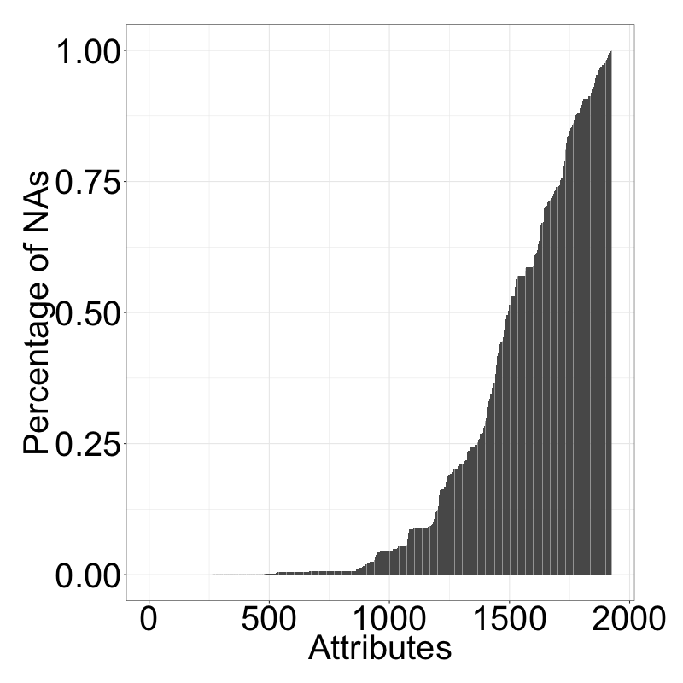
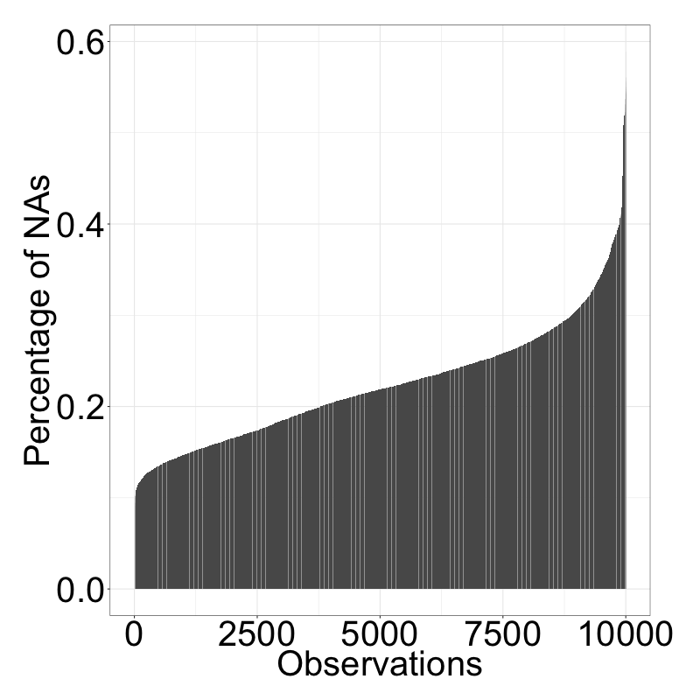
Number of Nas varies a lot per attribute and observation
NA values per attribute in %
NA values per sample in %

Slide 22
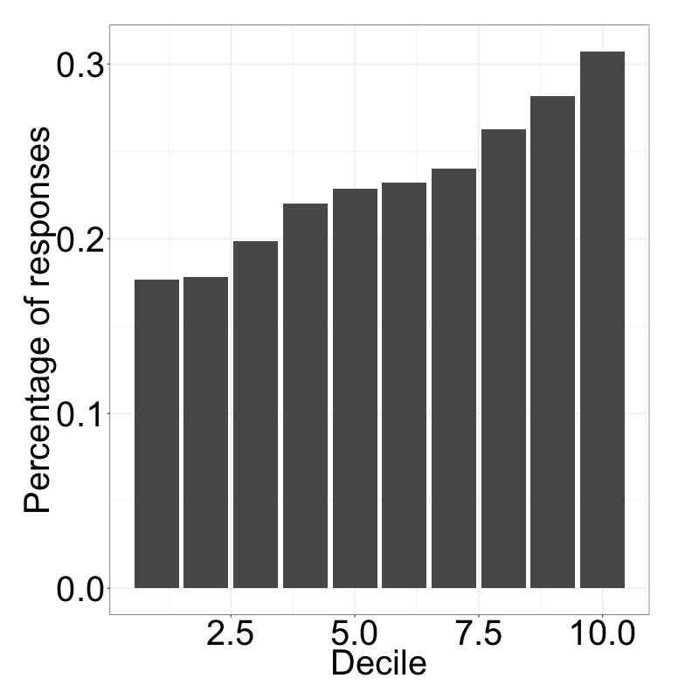
Completeness of observation highly impacts target variable
Result
Taking only complete samples or complete attributes is no valid option
Value imputation is required
Incompleteness of sample

Slide 23
“Missingness” structure of attributes matters for imputation
Imputation with similar NA structure
Attribute B
NA
NA
3
10
NA
4
5
1

Slide 24
“Missingness” structure of attributes matters for imputation
Imputation with similar NA structure
Attribute A
Attribute B
1529
1002
NA
NA
141
NA
NA
174
NA
NA
3
10
NA
4
5
1
X

Slide 25
“Missingness” structure of attributes matters for imputation
Imputation with similar NA structure
Attribute A
Attribute B
Attribute C
1529
1002
NA
NA
141
NA
NA
174
NA
NA
3
10
NA
4
5
1
0
9
4
NA
4
NA
9
0
X

Slide 26
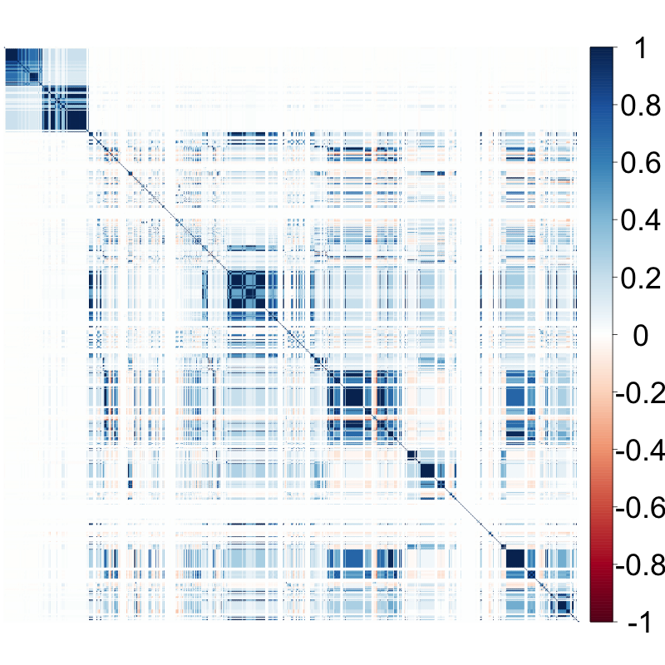
“Missingness” structure of attributes matters for imputation
Imputation with similar NA structure
Missingness correlations
Attribute A
Attribute B
Attribute C
1529
1002
NA
NA
141
NA
NA
174
NA
NA
3
10
NA
4
5
1
0
9
4
NA
4
NA
9
0
X
Many closeby variables have the same missingness patterns. Apparently, data was collected in chunks or split up later. This is problematic for our imputation.

Slide 27
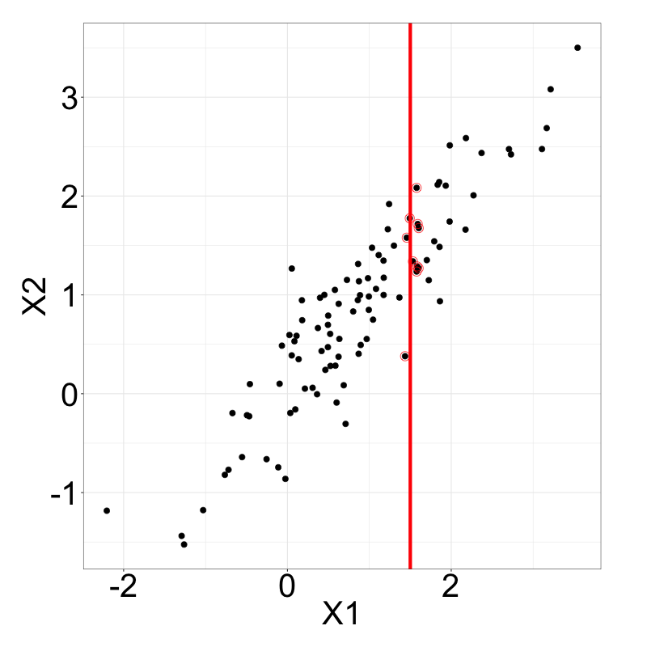
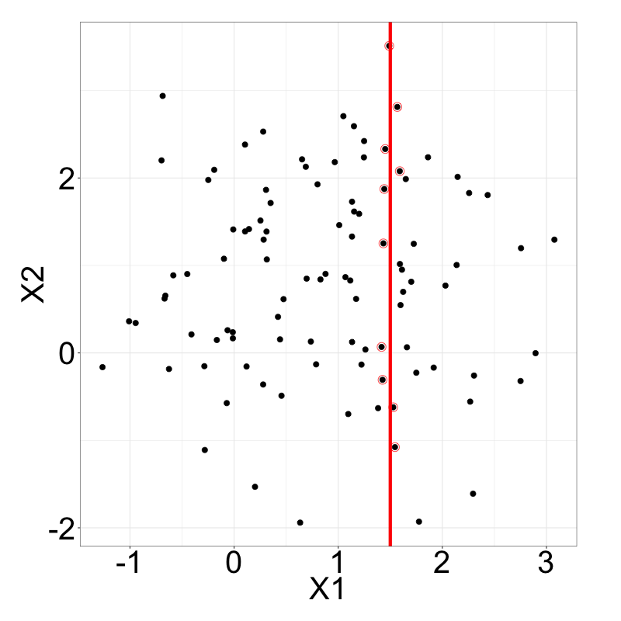
Attributes for imputation should be correlated to each other
Multivariate random samples (cor = 0.9)
Multivariate random samples (cor = 0)
candidates
candidates
For imputation, we select the top five variables in terms of correlation, that have a missingness correlation of lower than 0.7.

Slide 28
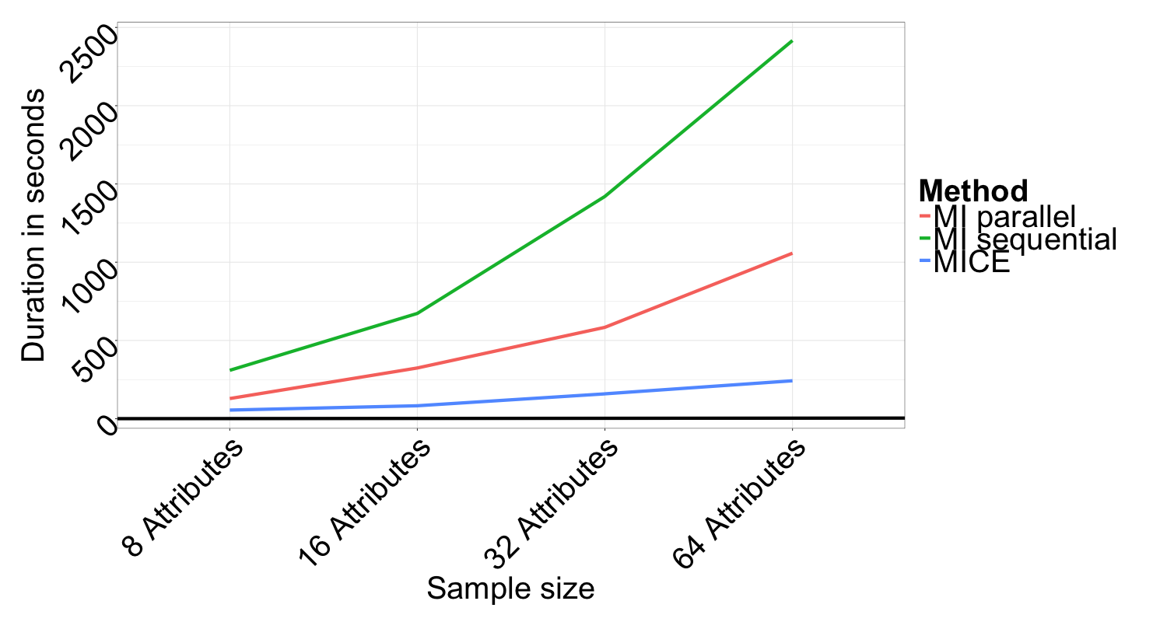
MICE imputation fastest but does not run on the dataset
MICE fastest, but fails for some attributes (-> fails for the whole computation)
MI also fails for some but can be divided per attribute
Own parallel implementation of MI faster than MI, so this was taken for imputation

Slide 29
Agenda
Data understanding
Data cleaning
Value imputation
Machine learning approaches
Results

Slide 30
regression still most used technique for big data analysis
Publications on big data in the last five years¹
Source: 1) Scopus keyword search; inspirations from Al-Jarrah et al. (2015), Berral-Garcia (2016), Gupta et al. (2016), Qiu et al. (2016), Richter et al. (2015), Sharma et al. (2013)

Slide 31
SOURCE
Logistic regression, svms, anns, knn discarded
RPART | Random Forest | Xtreme Gradient Boosting
Tree-based model
Basic method | Ensemble method
Grows tree and prunes | Grows deep trees | Grows one tree per round
Fit a single tree | Fit many independent trees | Iterative model improvement
Predict by leaf | Predict by majority vote | Predict by latest model iteration

Slide 32



On Decision trees
sex=male
A tree visualizes a set of binary rules
An observation will end up in a leaf, which assigns its class to the observation
Algorithms usually work top-down, by choosing at each step the variable that best splits the observations
Likes gaming
age<14
Likes gaming
Doesn’t like gaming
Trees tend to grow very deep, which results in overfitting.
Countermeasures:
Pruning
Column subsamples
Row subsamples
Tree ensembles

Slide 33



Boosters convert weak learners to strong ones
Boosting algorithms fit iteratively weak learners of the same type
Learner 1
Next iteration focuses on previously misclassified data
Weighted Data
Learner 2
$$Σ$$
Adding up all learners with weights gives a powerful learner
Weighted Data
…
Gives state-of-the-art results on many standard classification benchmarks¹
Source: Li (2012)

Slide 34
eXtreme gradient Boosting (xgboost)
Popular boosting algorithm
How
Builds on Gradient Boosting Method, where “shortcomings” in previous learners are identified by gradients
Improves it through simplified tree building, pruning and parallel processing
Approximated splitting algorithm makes it faster
does it work?
Why
is it used?
Power
Speed
Customization
Chen, Tianqi, and Carlos Guestrin. "Xgboost: A scalable tree boosting system." arXiv preprint arXiv:1603.02754 (2016).
Notes:
Loss controls predictive power,
Complexity prevents overfitting

Slide 35
Agenda
Data understanding
Data cleaning
Value imputation
Machine learning approaches
Results

Slide 36
The area under curved can be used for visual performance evaluation
ROC curves visualize binary classification performance
The better a classifier, the closer its curve is to the top-left corner
The threshold of a classifier defines a point on the curve
AUC summarizes the performance and lies between 0 and 1
P(TP)
P(FP)
random guess
classifiers
Notes:
P(TP)=probability of detection, sensitivity
AUC is equal to the probability that a classifier will rank a randomly chosen positive instance higher than a randomly chosen negative one (assuming 'positive' ranks higher than 'negative')

Slide 37
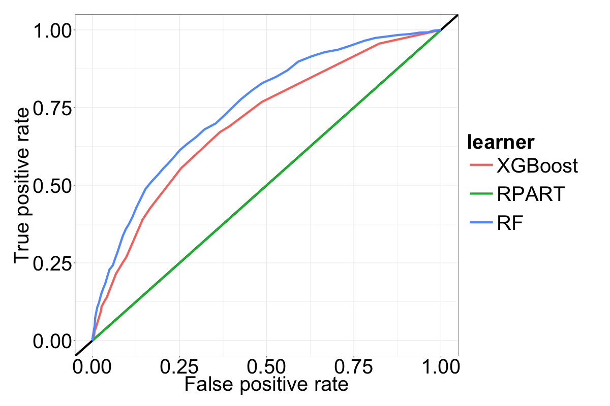
Tracker
Random forest performs best on default settings
ROC curves for default algorithms

Slide 38
Tuning example xgboost
ROC curves for different subsets

Slide 39
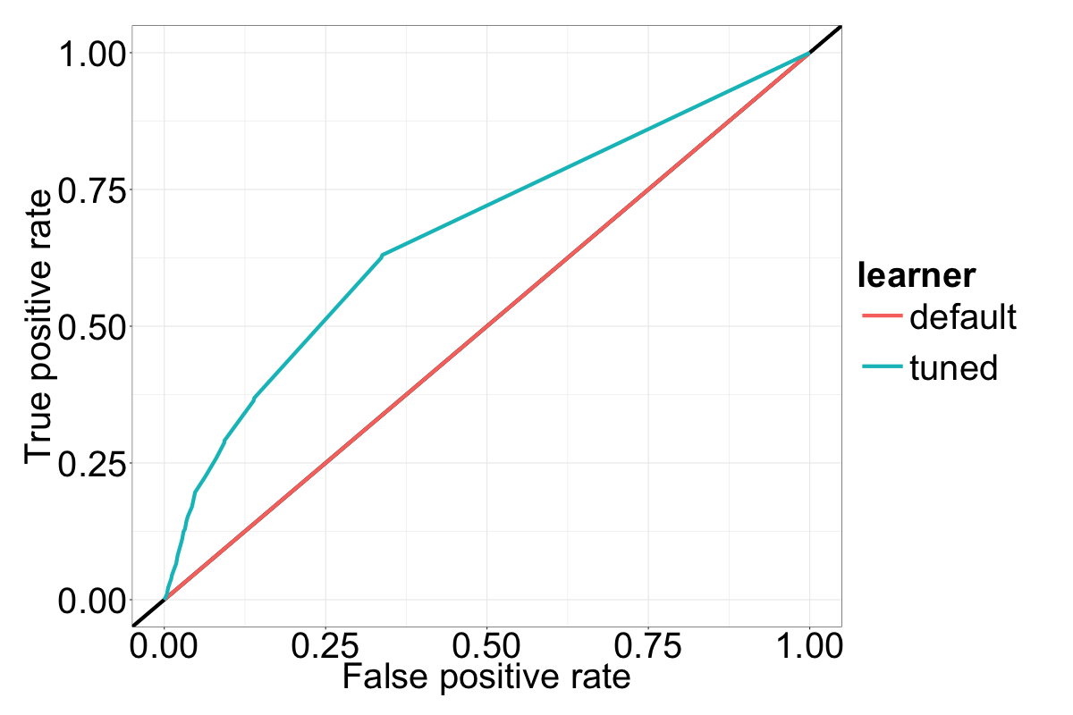
Parameter tuning for Rpart yields significant improvements
ROC curves for default and tuned algorithm (rpart)

Slide 40
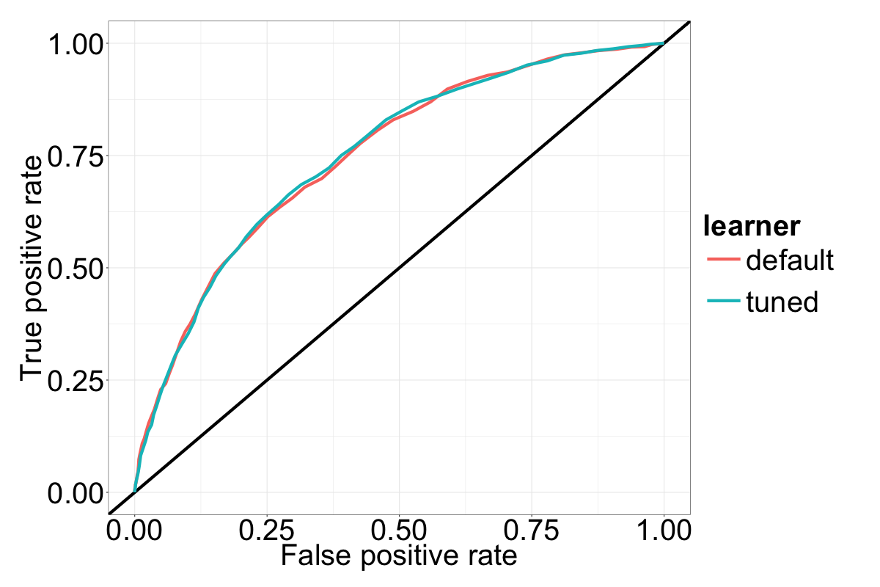
Parameter tuning for random forest yields non-significant improvements
ROC curves for default and tuned algorithm (Random Forest)

Slide 41
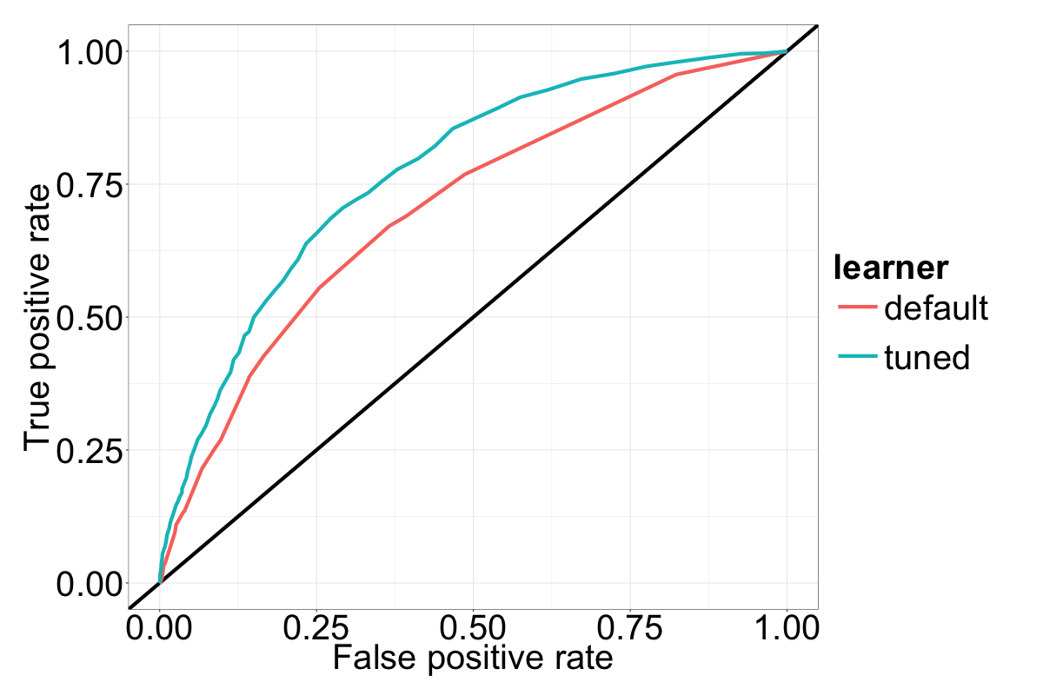
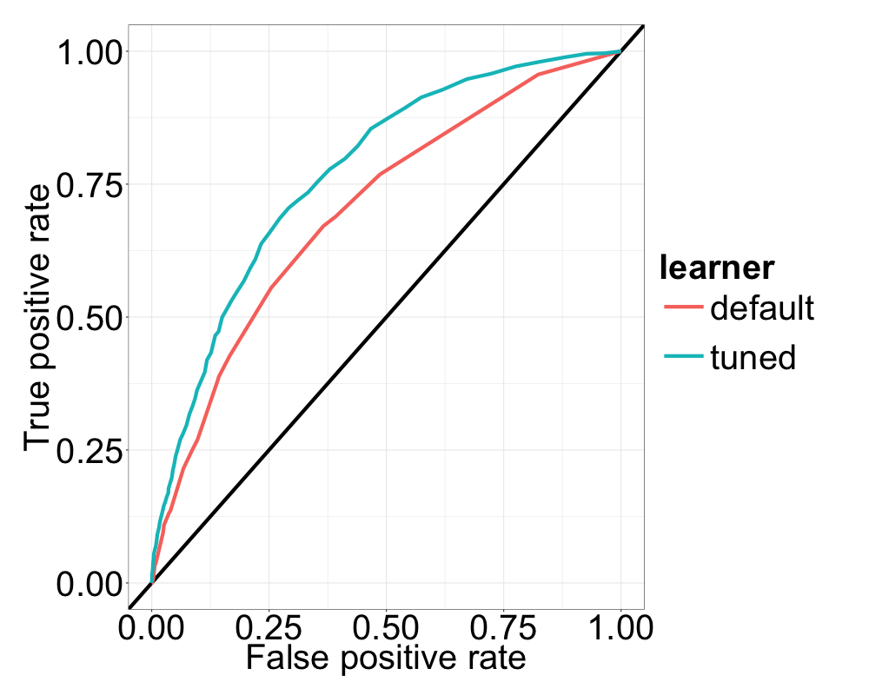
Parameter for xgboost yields The highest improvements
ROC curves for default and tuned algorithm (XGBOOST)

Slide 42
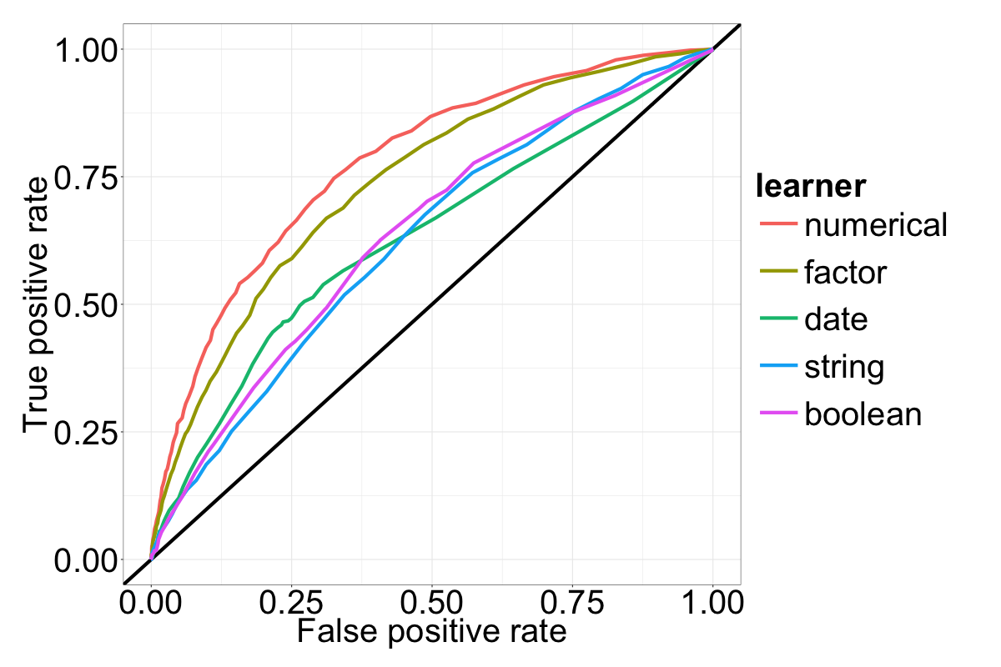
Predictions are better the more attributes a subset has
ROC curves for different subsets
AUC:
0.773
0.739
0.628
0.624
0.638

Slide 43
Tuned algorithms sample
ROC curves for different subsets

Slide 44
Tuned algorithms whole set
ROC curves for different subsets

Slide 45
Time consumption
ROC curves for different subsets

Slide 46
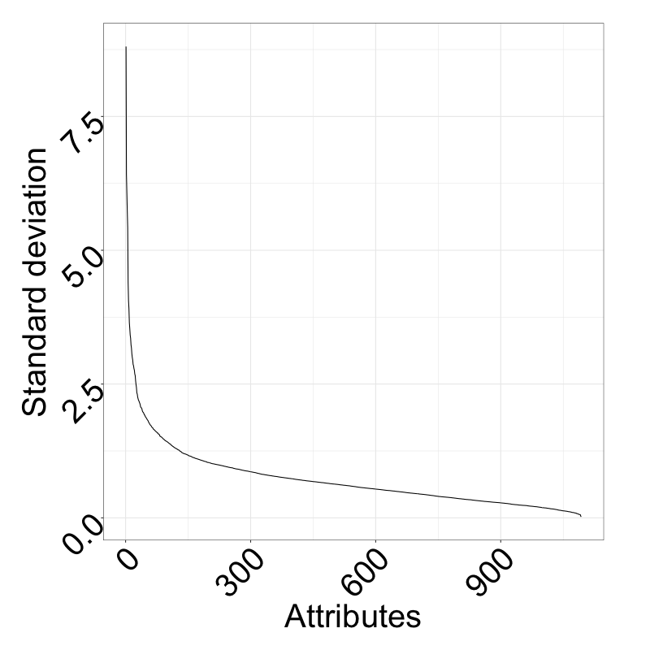
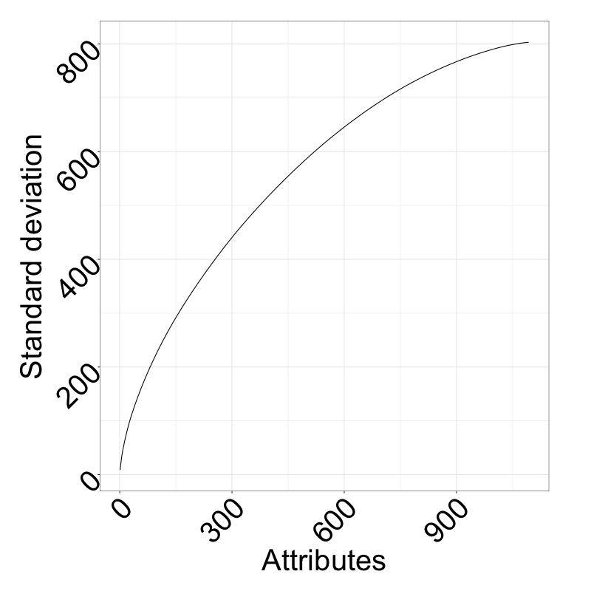
PCA reveals steep curve; however, no distinct elbow can be identified
Explained variance by PCs
Cumsum of variance of PCs
The first 453 PCs explain more than 80% of the variance; decreasing the dimensionality might be utilized for performance improvements.

Slide 47
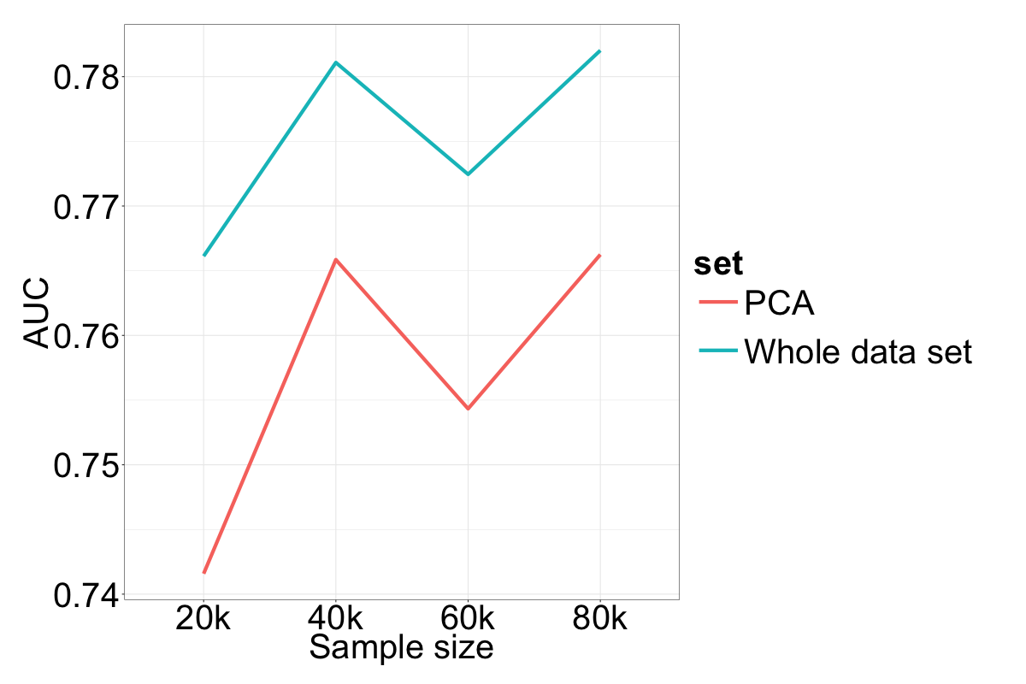
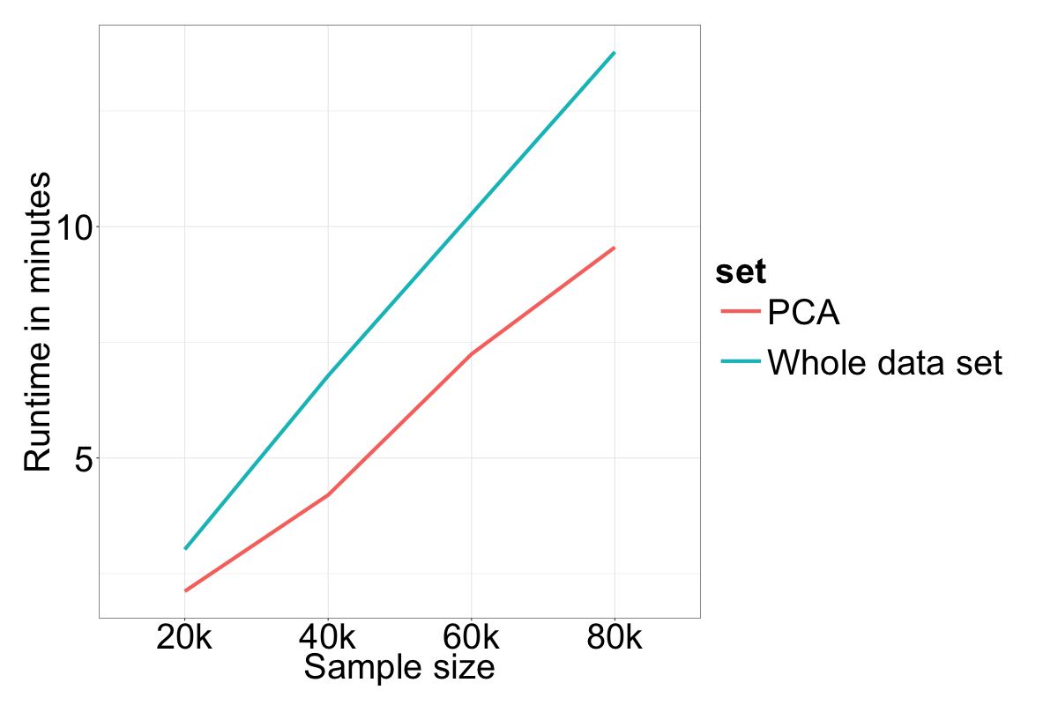
PCA shows a tradeoff between auc and runtime performance
Runtimes and AUCs for different sample sizes for whole set and first 453 PCs

Slide 48
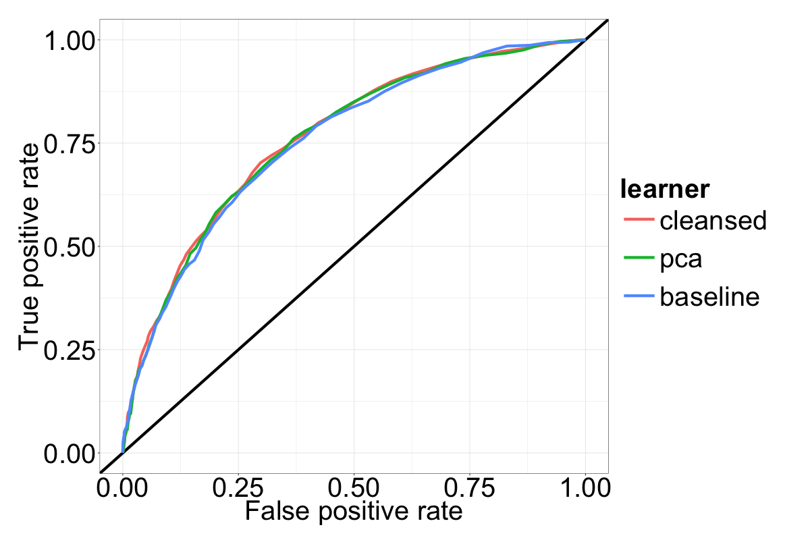
Dataset transformation have little impact on prediction quality
ROC curves for different datasets
AUC:
0.765
0.762
0.757

Slide 49





Lessons learned
Data cleaning
Stability of R
Sentiment analysis¹
Voice classification²
Automatic speaker recognition³
Speech to text systems⁴
Machine failure recognition⁶
Military sound analysis⁶
Animal sound recog-nition (e.g. birds)⁷
Performance
Resource restrictions
Genre identification⁵
Instrumentation⁵
Dynamics, tempo and timbre⁵
Medical hearing aid⁶
Adaptive noise cancelling⁶
Digital watermarking⁶

Slide 51
References
Al-Jarrah, Omar Y., et al. "Efficient machine learning for big data: A review." Big Data Research 2.3 (2015): 87-93.
Berral-García, Josep Lluis. "A quick view on current techniques and machine learning algorithms for big data analytics." Transparent Optical Networks (ICTON), 2016 18th International Conference on. IEEE, 2016.
Gupta, Preeti, Arun Sharma, and Rajni Jindal. "Scalable machine‐learning algorithms for big data analytics: a comprehensive review." Wiley Interdisciplinary Reviews: Data Mining and Knowledge Discovery 6.6 (2016): 194-214.
Qiu, Junfei, et al. "A survey of machine learning for big data processing." EURASIP Journal on Advances in Signal Processing 2016.1 (2016): 1-16.
Richter, Aaron N., et al. "A Multi-Dimensional Comparison of Toolkits for Machine Learning with Big Data." Information Reuse and Integration (IRI), 2015 IEEE International Conference on. IEEE, 2015.
Sharma, Seema, et al. "Machine learning techniques for data mining: A survey." Computational Intelligence and Computing Research (ICCIC), 2013 IEEE International Conference on. IEEE, 2013.
Li, Ping. "Robust logitboost and adaptive base class (abc) logitboost." arXiv preprint arXiv:1203.3491 (2012).
Pete Chapman, Julian Clinton, Randy Kerber, Thomas Khabaza, Thomas Reinartz, Colin Shearer, and Rudiger Wirth. CRISP-DM 1.0 Step-by-step data mining guide. Technical report, The CRISP-DM consortium, August 2000.

Slide 52
